Slide 1
Database Management Systems and SQL
Session 2

Slide 2
DATABASE
Collection of Logically related tables
Why Multiple tables ?

Slide 3
Keys and Foreign Keys
Key
Product
PName | Price | Category | Manufacturer
Gizmo | 19.99 | Gadgets | GizmoWorks
Powergizmo | 29.99 | Gadgets | GizmoWorks
SingleTouch | 149.99 | Photography | Canon
MultiTouch | 203.99 | Household | Hitachi

Slide 4
Keys and Foreign Keys
Key
Product
PName | Price | Category | Manufacturer | Order_id | Ord_date | Qty
Gizmo | 19.99 | Gadgets | GizmoWorks
Powergizmo | 29.99 | Gadgets | GizmoWorks | 101 | 2019/11/12 | 15
SingleTouch | 149.99 | Photography | Canon | 102 | 2019/12/13 | 10
MultiTouch | 203.99 | Household | Hitachi | 103 | 2019/12/11 | 20

Slide 5
Keys and Foreign Keys
Key
Product
Key
PName | Price | Category | Manufacturer | Order_id | Ord_date | Qty
Gizmo | 19.99 | Gadgets | GizmoWorks | Null | Null | Null
Powergizmo | 29.99 | Gadgets | GizmoWorks | 101 | 2019/11/12 | 15
SingleTouch | 149.99 | Photography | Canon | 102 | 2019/12/13 | 10
MultiTouch | 203.99 | Household | Hitachi | 103 | 2019/12/11 | 20
Powergizmo | 29.99 | Gadgets | GizmoWorks | 104 | 2019/11/22 | 10
SingleTouch | 149.99 | Photography | Canon | 105 | 2019/12/23 | 15
Data redundancy : multiple orders for same product

Slide 6
Keys and Foreign Keys
Key
Product
PName | Price | Category | Manufacturer | Reg_Date | Stock Price | Country
Gizmo | 19.99 | Gadgets | GizmoWorks | 2019/10/21 | 25 | USA
Powergizmo | 29.99 | Gadgets | GizmoWorks | 2019/10/21 | 25 | USA
SingleTouch | 149.99 | Photography | Canon | 2019/10/3 | 65 | Japan
MultiTouch | 203.99 | Household | Hitachi | 2019/10/10 | 15 | India
Can't Insert manufacturer details
Deletion of product will delete the details of manufacturer

Slide 7
PName | Price | Category | Manufacturer | Order_id | Ord_date | Qty
Gizmo | 19.99 | Gadgets | GizmoWorks | Null | Null | Null
Powergizmo | 29.99 | Gadgets | GizmoWorks | 101 | 2019/11/12 | 13
SingleTouch | 149.99 | Photography | Canon | 102 | 2019/12/13 | 12
MultiTouch | 203.99 | Household | Hitachi | 103 | 2019/12/11 | 10
Powergizmo | 29.99 | Gadgets | GizmoWorks | 104 | 2019/11/22 | 10
SingleTouch | 149.99 | Photography | Canon | 105 | 2019/12/23 | 15
Product
Orders
PName | Price | Category | Manufacturer
Gizmo | $19.99 | Gadgets | GizmoWorks
Powergizmo | $29.99 | Gadgets | GizmoWorks
SingleTouch | $149.99 | Photography | Canon
MultiTouch | $203.99 | Household | Hitachi
Order_id | ODate | Qty | Prname
101 | 2019/11/12 | 15 | Powergizmo
102 | 2019/12/13 | 10 | SingleTouch
103 | 2019/1211 | 20 | MultiTouch

Slide 8
Keys and Foreign Keys
Foreign
Key
Key
Orders
Order_id | ODate | QUANTITY | Prname
101 | 2019/11/12 | 15 | Powergizmo
102 | 2019/12/13 | 10 | SingleTouch
103 | 2019/1211 | 20 | MultiTouch
Key
Product
PName | Price | Category | Manufacturer
Gizmo | $19.99 | Gadgets | GizmoWorks
Powergizmo | $29.99 | Gadgets | GizmoWorks
SingleTouch | $149.99 | Photography | Canon
MultiTouch | $203.99 | Household | Hitachi

Slide 9
PName | Price | Category | Manufacturer | Reg_Date | Stock Price | Country
Gizmo | 19.99 | Gadgets | GizmoWorks | 2019/10/21 | 25 | USA
Powergizmo | 29.99 | Gadgets | GizmoWorks | 2019/10/21 | 25 | USA
SingleTouch | 149.99 | Photography | Canon | 2019/10/3 | 65 | Japan
MultiTouch | 203.99 | Household | Hitachi | 2019/10/10 | 15 | India
COMPDTLS
Product
CompName | RegDate | Stock Price | Country
GizmoWorks | 2019/10/21 | 25 | USA
Canon | 2019/10/3 | 65 | Japan
Hitachi | 2019/10/10 | 15 | India
PName | Price | Category | Manufacturer
Gizmo | $19.99 | Gadgets | GizmoWorks
Powergizmo | $29.99 | Gadgets | GizmoWorks
SingleTouch | $149.99 | Photography | Canon
MultiTouch | $203.99 | Household | Hitachi

Slide 10
Keys and Foreign Keys
Key
COMPDTLS
CompName | RegDate | Stock Price | Country
GizmoWorks | 2019/10/21 | 25 | USA
Canon | 2019/10/3 | 65 | Japan
Hitachi | 2019/10/10 | 15 | India
Key
Product
PName | Price | Category | Manufacturer
Gizmo | $19.99 | Gadgets | GizmoWorks
Powergizmo | $29.99 | Gadgets | GizmoWorks
SingleTouch | $149.99 | Photography | Canon
MultiTouch | $203.99 | Household | Hitachi
Foreign
key

Slide 11
Company
Foreign
key
Orders
COMPDTLS
Order_id | ODate | Qty | Prname
101 | 2019/11/12 | 15 | Powergizmo
102 | 2019/12/13 | 10 | SingleTouch
103 | 2019/1211 | 20 | MultiTouch
CompName | RegDate | Stock Price | Country
GizmoWorks | 2019/10/21 | 25 | USA
Canon | 2019/10/3 | 65 | Japan
Hitachi | 2019/10/10 | 15 | India
Product
PName | Price | Category | Manufacturer
Gizmo | $19.99 | Gadgets | GizmoWorks
Powergizmo | $29.99 | Gadgets | GizmoWorks
SingleTouch | $149.99 | Photography | Canon
MultiTouch | $203.99 | Household | Hitachi
Foreign
key

Slide 12
Foreign Keys : Value of FK either equals to the value of PK to which it is referred or NULL

Slide 13
Create table Orders
Foreign
Key
Key
Orders
Order_id | ODate | Qty | Prname
101 | 2019/11/12 | 15 | Powergizmo
102 | 2019/12/13 | 10 | SingleTouch
103 | 2019/1211 | 20 | MultiTouch
create table orders(order_id varchar(5) primary key, odate date NOT NULL, qty int , prname varchar(20) references product(pname));

Slide 14
Insert into Orders
Orders
Order_id | ODate | Qty | Prname
101 | 2019/11/12 | 15 | Powergizmo
102 | 2019/12/13 | 10 | SingleTouch
103 | 2019/12/11 | 20 | MultiTouch
104 | 2019/12/12 | 5 | Powergizmo
105 | 2019/12/13 | 7 | MultiTouch

Slide 15
Joins
Orders
Product
Order_id | ODate | Qty | Prname
101 | 2019/11/12 | 15 | Powergizmo
102 | 2019/12/13 | 10 | SingleTouch
103 | 2019/12/11 | 20 | MultiTouch
104 | 2019/12/12 | 5 | Powergizmo
105 | 2019/12/13 | 7 | MultiTouch
PName | Price | Category | Manufacturer
Gizmo | $19.99 | Gadgets | GizmoWorks
Powergizmo | $29.99 | Gadgets | GizmoWorks
SingleTouch | $149.99 | Photography | Canon
MultiTouch | $203.99 | Household | Hitachi
Show the pname, price, orderid, qty
Select pname, price, order_id from product, orders where pname=prname
Join
between Product
and Order

Slide 16
Joins
Product (pname, price, category, manufacturer)
orders(order_id, odate,qty, prname)
Find all products names and odate of category gadgets;
Select pname, odate from product, orders where product.pname= orders.prname and category=“Gadgets”;
List the products names whose ordered qty is greater than 10;
Select pname from orders where qty>10;

Slide 17
Simple Aggregation
Product
PName | Price | Category | Manufacturer
Gizmo | 19.99 | Gadgets | GizmoWorks
Powergizmo | 29.99 | Gadgets | GizmoWorks
SingleTouch | 149.99 | Photography | Canon
MultiTouch | 203.99 | Household | Hitachi
SELECT sum(price*3)
FROM Product;
SELECT (price*3) as increased_price
FROM Product;

Slide 18
Simple Aggregation
Product
Orders
PName | Price | Category | Manufacturer
Gizmo | $19.99 | Gadgets | GizmoWorks
Powergizmo | $29.99 | Gadgets | GizmoWorks
SingleTouch | $149.99 | Photography | Canon
MultiTouch | $203.99 | Household | Hitachi
Order_id | ODate | Qty | Prname
101 | 2019/11/12 | 15 | Powergizmo
102 | 2019/12/13 | 10 | SingleTouch
103 | 2019/12/11 | 20 | MultiTouch
104 | 2019/12/12 | 5 | Powergizmo
105 | 2019/12/13 | 7 | MultiTouch
Show the amount of all orders i.e. price* qty
Select (price*qty) as amount from product, orders where pname=prname ;

Slide 19
Grouping and Aggregation
Find total price of each category
Product
PName | Price | Category | Manufacturer
Gizmo | 19.99 | Gadgets | GizmoWorks
Powergizmo | 29.99 | Gadgets | GizmoWorks
SingleTouch | 149.99 | Photography | Canon
MultiTouch | 203.99 | Household | Hitachi
SELECT Sum(price)
FROM Product
GROUP BY category
Count the no of products manufactured by each manufacturer
SELECT count(*)
FROM Product
GROUP BY manufacturer

Slide 20
GROUP BY WITH ORDER BY
Product
PName | Price | Category | Manufacturer
Gizmo | 19.99 | Gadgets | GizmoWorks
Powergizmo | 29.99 | Gadgets | GizmoWorks
SingleTouch | 149.99 | Photography | Canon
MultiTouch | 203.99 | Household | Hitachi
Find total no of products of each manufacturer in order of no of products
SELECT COUNT(PNAME), manufacturer
FROM product
GROUP BY manufacturer
ORDER BY COUNT (PNAME);

Slide 21
Having Clause: conditions on aggregates
Product
PName | Price | Category | Manufacturer
Gizmo | 19.99 | Gadgets | GizmoWorks
Powergizmo | 29.99 | Gadgets | GizmoWorks
SingleTouch | 149.99 | Photography | Canon
MultiTouch | 203.99 | Household | Hitachi
Find no of products manufactured by each manufacturer with more than sum price >100.
SELECT COUNT(PNAME), manufacturer FROM product
GROUP BY manufacturer
HAVING sum(price) >100;

Slide 22
Having Clause: conditions on aggregates
Orders
Order_id | ODate | Qty | Prname
101 | 2019/11/12 | 15 | Powergizmo
102 | 2019/12/13 | 10 | SingleTouch
103 | 2019/12/11 | 20 | MultiTouch
104 | 2019/12/12 | 5 | Powergizmo
105 | 2019/12/13 | 7 | MultiTouch
Find no of orders of each product having more than1.
SELECT COUNT(order_id), prname FROM orders
GROUP BY prname
HAVING count(order_id) >1;

Slide 23
NULLS in SQL
Whenever we don’t have a value, we can put a NULL
Can mean many things:
  Value does not exists
  Value exists but is unknown
  Value not applicable
  Etc.
The schema specifies for each attribute if can be null (nullable attribute) or not
How does SQL cope with tables that have NULLs ?

Slide 24
Null Values
If x= NULL then 4*(3-x)/7 is still NULL
If x= NULL then x=“Joe” is UNKNOWN

Slide 25
Deletions
Product
PName | Price | Category | Manufacturer
Gizmo | 19.99 | Gadgets | GizmoWorks
Powergizmo | 29.99 | Gadgets | GizmoWorks
SingleTouch | 149.99 | Photography | Canon
MultiTouch | 203.99 | Household | Hitachi
DELETE FROM product
WHERE price<20

Slide 26
Deletions
Product
PName | Price | Category | Manufacturer
Gizmo | 19.99 | Gadgets | GizmoWorks
Powergizmo | 29.99 | Gadgets | GizmoWorks
SingleTouch | 149.99 | Photography | Canon
MultiTouch | 203.99 | Household | Hitachi
DELETE FROM product

Slide 27
Updation
Product
PName | Price | Category | Manufacturer
Gizmo | 19.99 | Gadgets | GizmoWorks
Powergizmo | 29.99 | Gadgets | GizmoWorks
SingleTouch | 149.99 | Photography | Canon
MultiTouch | 203.99 | Household | Hitachi
Set the price 200 of all products of gadgets category
Update product set price = 200
WHERE category = “gadgets”

Slide 28
Updation
Product
PName | Price | Category | Manufacturer
Gizmo | 19.99 | Gadgets | GizmoWorks
Powergizmo | 29.99 | Gadgets | GizmoWorks
SingleTouch | 149.99 | Photography | Canon
MultiTouch | 203.99 | Household | Hitachi
Increase the price of all products by 200
Update product set price = price+200

Slide 29
Updation
Product
PName | Price | Category | Manufacturer
Gizmo | 19.99 | Gadgets | GizmoWorks
Powergizmo | 29.99 | Gadgets | GizmoWorks
SingleTouch | 149.99 | Photography | Canon
MultiTouch | 203.99 | Household | Hitachi
Increase the price of all products of gizmo works by 10%
Update product set price = price+(price*0.1)
Where manufacturer=“gizmoworks”

Slide 30
Updates
Example:
UPDATE PRODUCT
SET price = price/2
WHERE Product.name IN
(SELECT product
FROM Purchase
WHERE Date =‘Oct, 25, 1999’);

Slide 31
Drop Commands:
Drop table product;

Slide 32
Alter Commands: use to alter the structure of table. E.g. add / delete columns, rename, change in datatypes, add or drop constraints

Slide 33
Alter Commands:
Add new column : pcode and quantity
ALTER TABLE <table_name> ADD <column_name datatype>;
ALTER TABLE product ADD pcode varchar(5);
ALTER TABLE product ADD Quantity int;

Slide 34
Alter Commands:
Drop column :
ALTER TABLE table_name DROP COLUMN column_name;
ALTER TABLE product DROP quantity

Slide 35
Alter Commands:
Modify existing Column
ALTER TABLE table_name MODIFY COLUMN column_name datatype;
ALTER TABLE product MODIFY COLUMN pcode varchar(10);

Slide 36
Alter Commands:
Modify existing Column: add constraints
ALTER TABLE table_name MODIFY column_name datatype NOT NULL;
ALTER TABLE compdtls MODIFY regdate date NOT NULL;

Slide 37
Alter Commands:
Modify existing Column: add primary key
ALTER TABLE product ADD CONSTRAINT pk PRIMARY KEY (pcode);

Slide 38
Alter Commands:
Modify existing Column: drop primary key
ALTER TABLE product DROP PRIMARY KEY;

Slide 39
Alter Commands:
Modify existing Column: add Foreign key
ALTER TABLE product
ADD FOREIGN KEY (manufacturer)
REFERENCES COMPDTLS(COMPNAME);

Slide 40
Nested Queries
Orders
Order_id | ODate | Qty | Prname
101 | 2019/11/12 | 15 | Powergizmo
102 | 2019/12/13 | 10 | SingleTouch
103 | 2019/12/11 | 20 | MultiTouch
104 | 2019/12/12 | 5 | Powergizmo
105 | 2019/12/13 | 7 | MultiTouch
Find product name with maximum qty ordered.
SELECT prname FROM orders where qty= (select max(qty) from orders);

Slide 41
Exercise: Nested Queries
Orders
COMPDTLS
Order_id | ODate | Qty | Prname
101 | 2019/11/12 | 15 | Powergizmo
102 | 2019/12/13 | 10 | SingleTouch
103 | 2019/1211 | 20 | MultiTouch
CompName | RegDate | Stock Price | Country
GizmoWorks | 2019/10/21 | 25 | USA
Canon | 2019/10/3 | 65 | Japan
Hitachi | 2019/10/10 | 15 | India
Product
PName | Price | Category | Manufacturer
Gizmo | $19.99 | Gadgets | GizmoWorks
Powergizmo | $29.99 | Gadgets | GizmoWorks
SingleTouch | $149.99 | Photography | Canon
MultiTouch | $203.99 | Household | Hitachi

Slide 42
Revision Tour

Slide 43
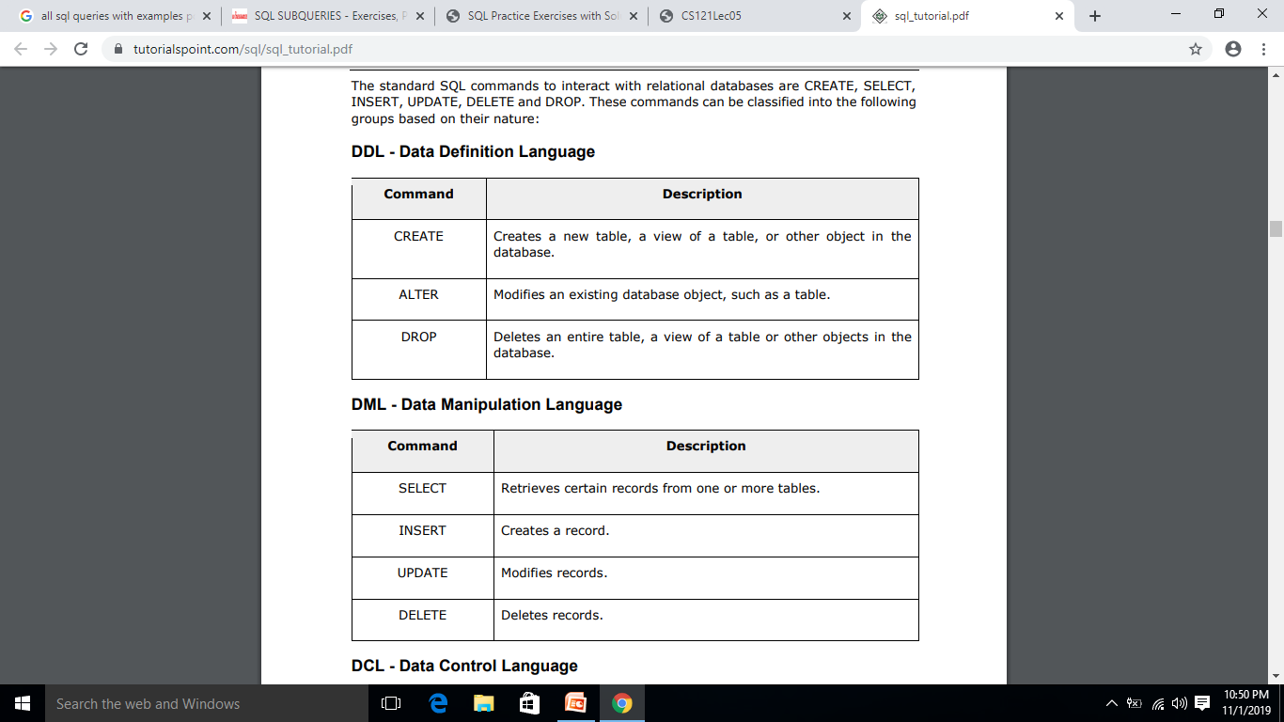

Slide 44
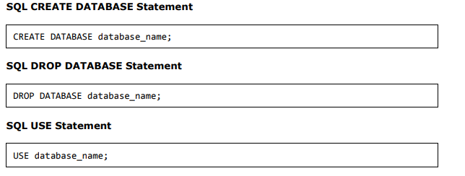
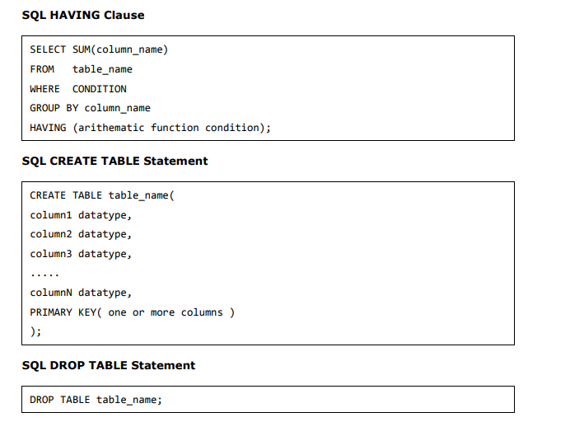

Slide 45
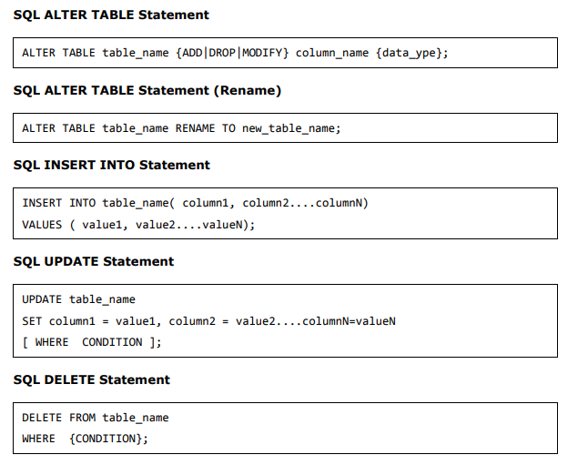

Slide 46
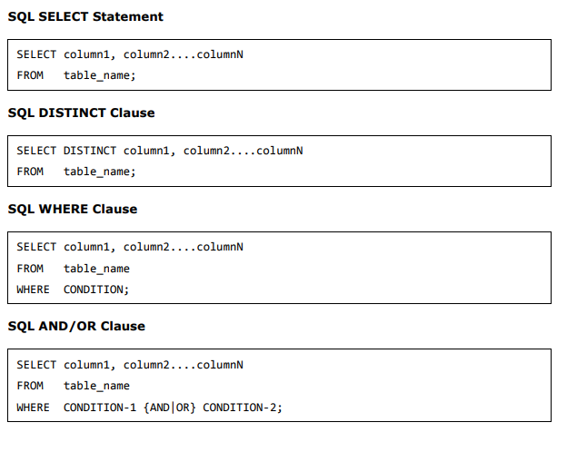

Slide 47
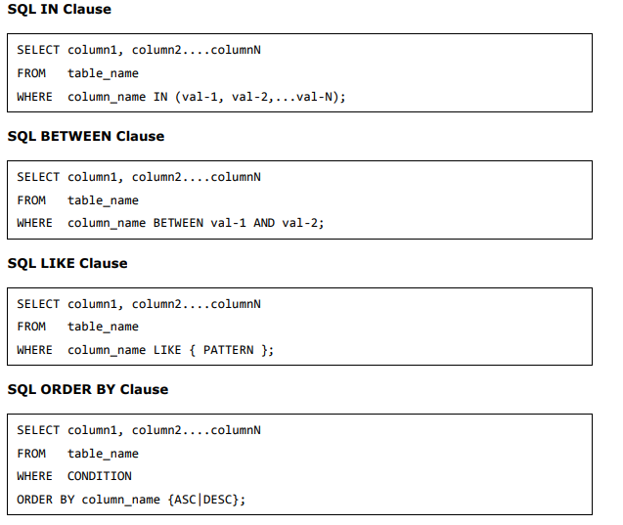

Slide 48
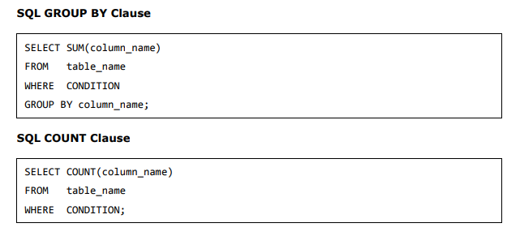

Slide 50
Exercise

Slide 51
Create Database Myorg with following two tables
Employee
Empid | Empname | designation | DOJ | Sal | Comm | Dept
Number | Varchar | Varchar | Date | Number | Number | Number
Department
Deptid | Deptname | Mgrid | Location
Number | Varchar | Number | Varchar

Slide 52
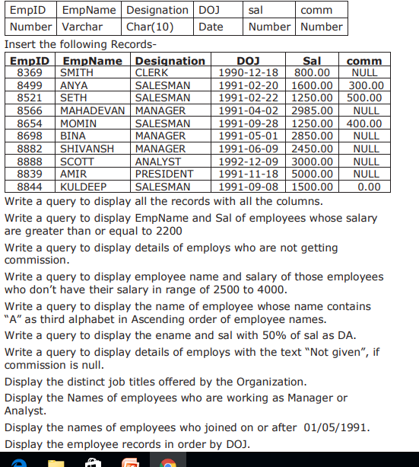
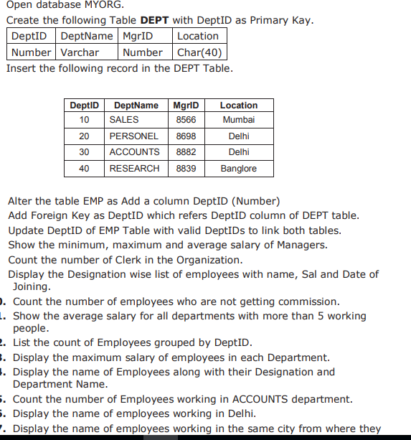
Populate Data : Employee
Department

Slide 54
Do the Following Queries

Slide 55
