Slide 1
Complex
Integration

Slide 2
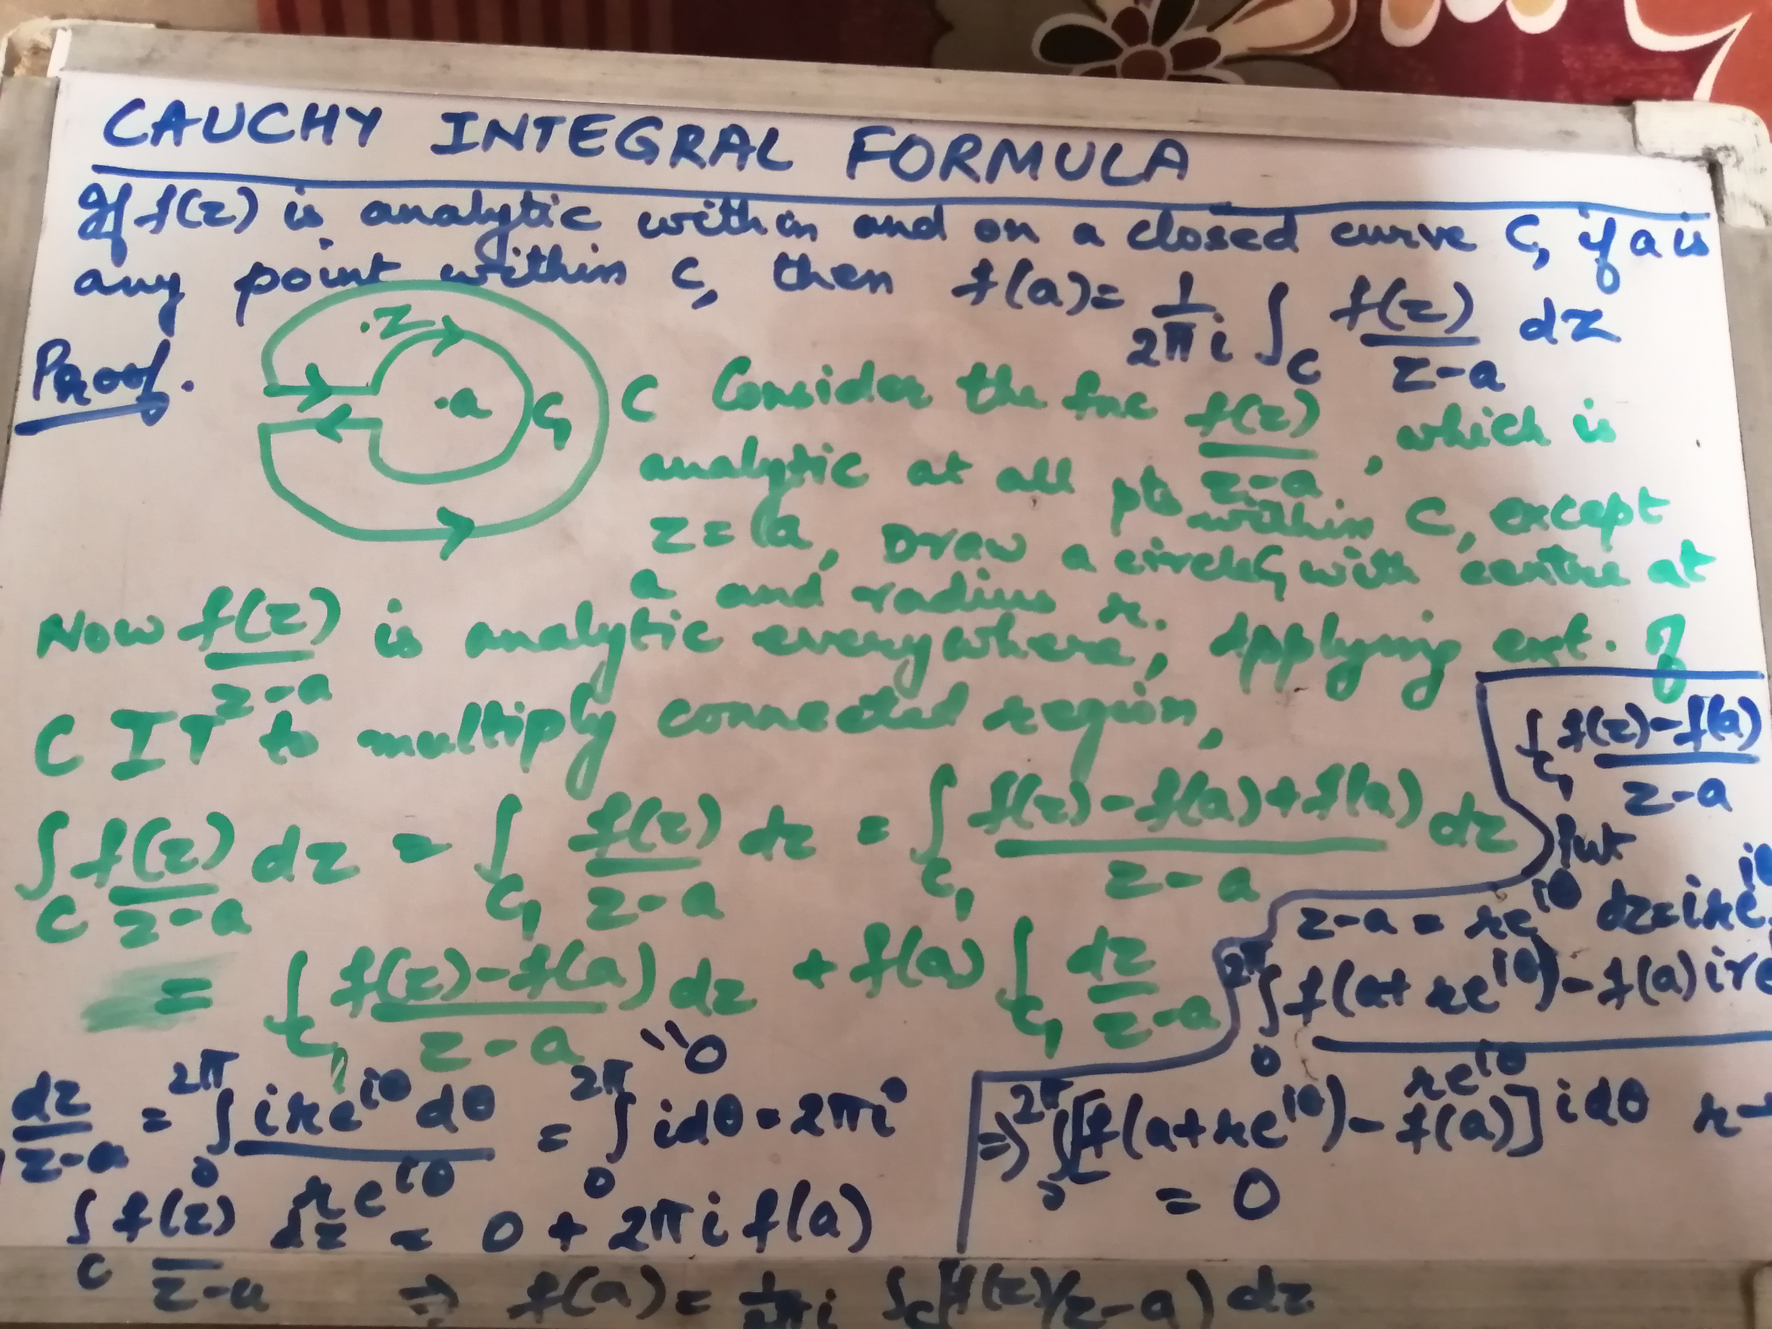

Slide 3
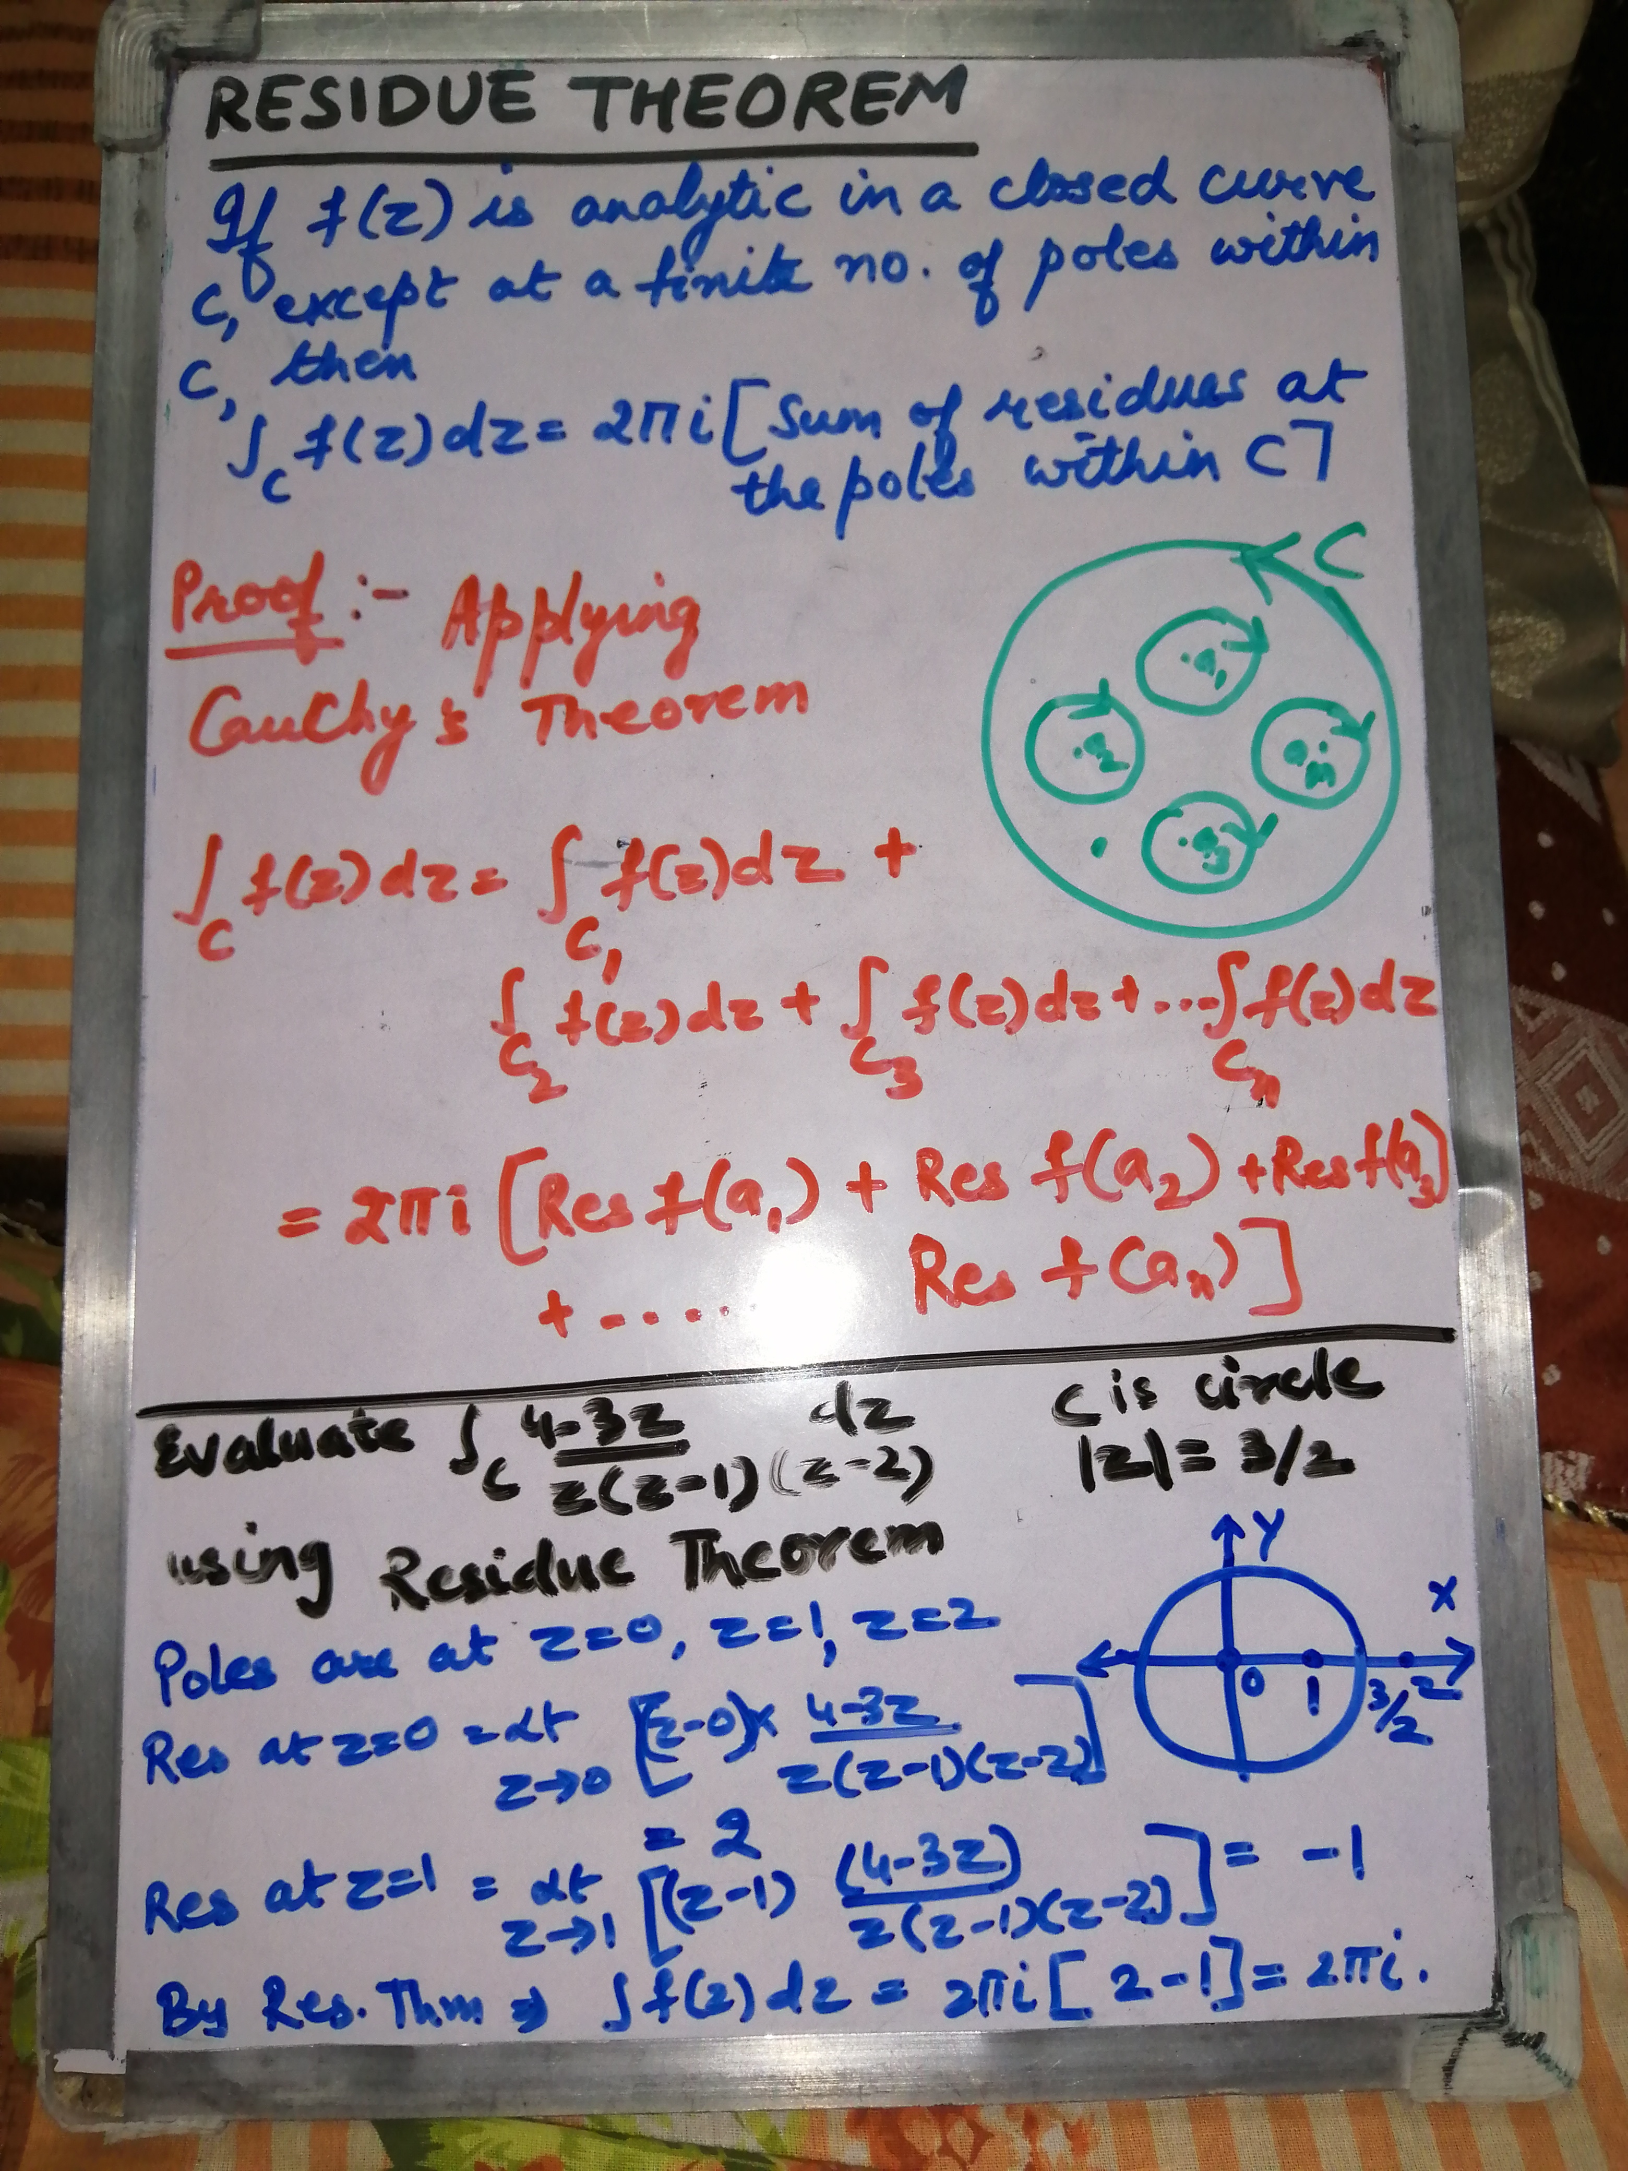

Slide 4
