Slide 1
PLANT VARIETY PROTECTION
(LS SEC IV-IPR)
By: Dr. Neha Yadav
Deshbandhu College
University of Delhi

Slide 2
Genesis of plant variety protection act
Various convention/treaties affecting biodiversity
CBD
IUPGR
UPOV
TRIPs

Slide 3
Convention on biological diversity
Legal binding document signed in Rio de Janerio earth-1992,170 member countries
Objectives:
Conservation of biodiversity
Sustainable use of biodiversity
Fair and equitable sharing of the benefits
Article 15 recognise sovereign rights over national resource

Slide 4

UPOV
An intergovernmental organisation which cooperates with WHO
Presentl 40 member mostly from developed world
Objectives:
Plant breeder’s rights and protection of plant variety
UPOV encourages the adoption of sui-generis law for protection of new plant varieties by creating distinct system outside of patent law

Slide 5
TRIPs
Article 27
Patent shall be available for any invention, whether product or process in field of technology
Article 27.3(b)
Plant and animal other than microorganisms and essentially biological processes for the production of plant and animal other than microbial processes
However members shall provide the information for the protection of plant varieties either by patents or by an effective sui-generis system or by any combination of thereof.

Slide 6
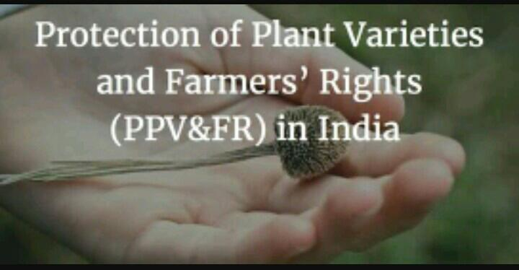
Status of protection of plant variety and farmer right act
PPVFR act passes in 2001
Rules are notified on September 2003
Authority established on December,2006 and June,30 2009
PPVFR act already enacted

Slide 7
Objective
To provide for the establishment of an effective system for protection of plant variety
To provide for the rights of farmers and plant breeder
To stimulate investment for research and development and to facilitate growth of the seed industry
To ensure availability of high quality seed and planting material of improved variety to farmers

Slide 8
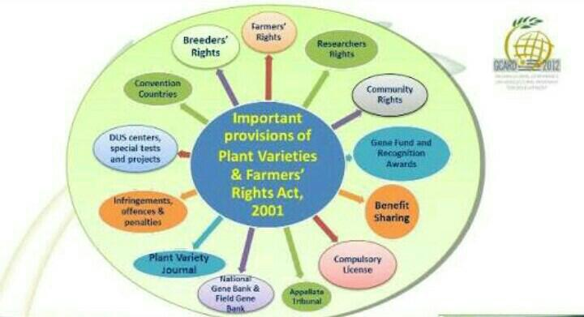

Slide 9
Criteria for registration of variety
Section 15 of act:
Novelty
Distinctiveness
Uniformity
Stability

Slide 10
Registerable plant variety
Noble variety
Extant variety
Essentially derived variety
Farmer variety

Slide 11
Application for registration
Every application for registration will have to be accompanied with the following information
Denomination assiged to such variety by the applicant
An affidavit sworn by he applicant that such variety does not contain any gene or gene sequence involving terminator technology
The applicant should be in such form as may be specified by regulations
A complete passport that a of the parental line from which the variety has been drived along with the geographical location in India from where the genetic material has been taken and all such information related to the contributio if any of farmer village community institution or organization in breeding evolving or developing the variety
A statement containing a brief description of the variety brining out its characteristics of novelty distinctiveness uniformity and stability has required for registration
Such fees as may be prescribed
Containing a declaration the genetic material or parental material acquired for breeding evolving or developing variety has been lawfully acquired

Slide 12
Period of protection
In case of trees and vines 18 year from date of registration of variety
In case of extent variety 15 years from the date of registration of variety
In case of other variety 15 years from date of registration of variety

Slide 13
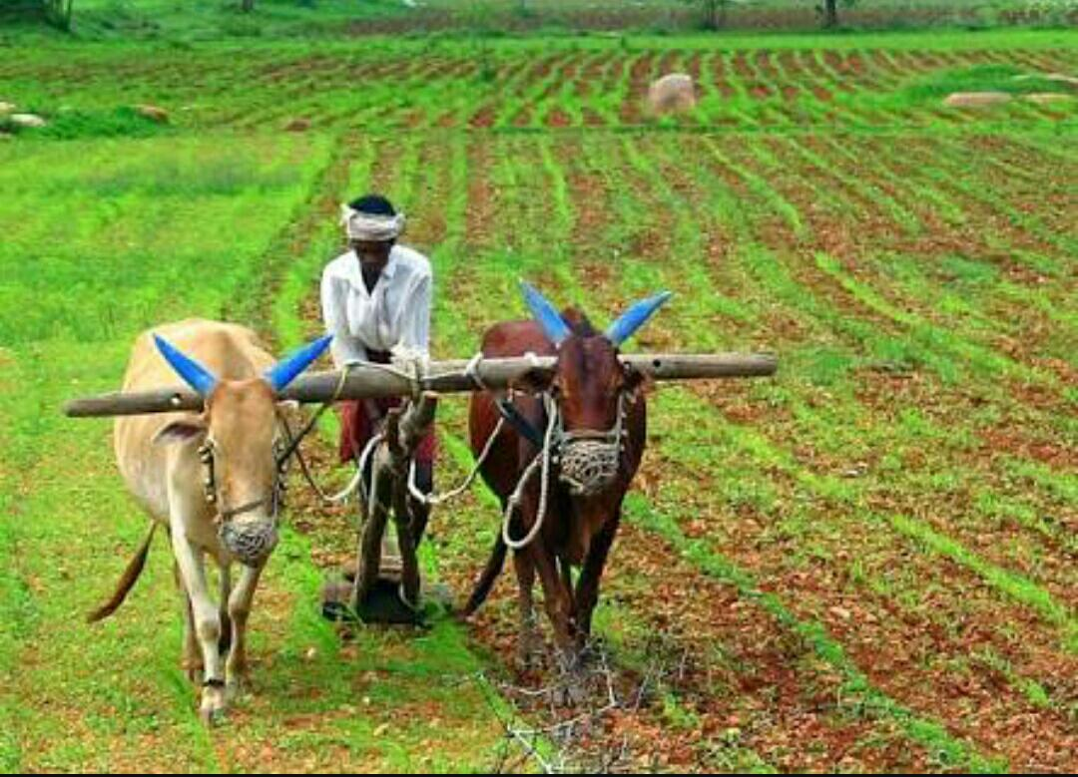
Farmers rights
Entitled to save,use,resow, exchange or sell his farm produce
Compensation for failure of expected performance of registered variety
Protection against innocent infringement
Exemption from payment of DUS testing fee

Slide 14
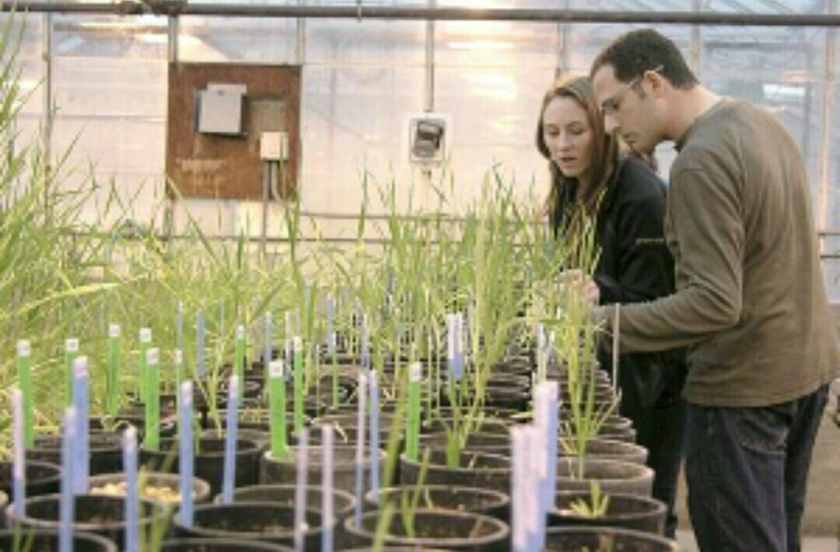
Researcher’s rights
The use of any variety for conducting research
The use of a variety for the purpose of creating other varieties

Slide 15
Breeder’s rights
Rights to:
Produce
Sell, market, distribute
Import/export seeds of the variety
Breeder authorization for production, commercial exploitation of plant variety
Penalties for infringement of breeder right

Slide 16
Communities rights
The right of community:
Provide for compensation for the contribution of communities in the evolution of new plant variety

Slide 17
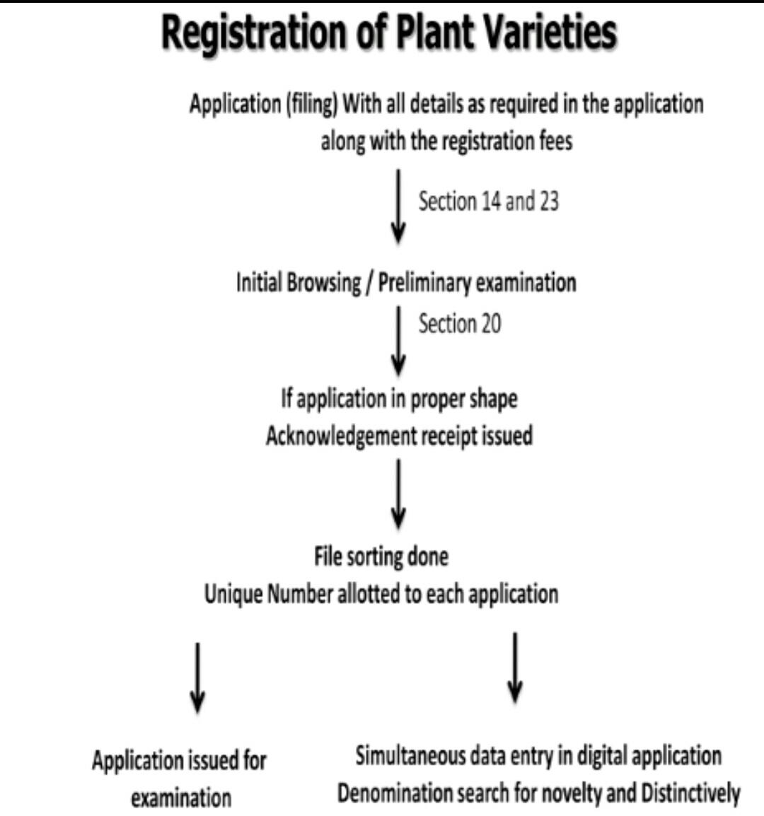
Procedure for registration

Slide 18
Compulsory license
The authority can grant compulsory license in case of any complaints about the availability of the seed of any registered variety to public at a reasonable price.The license can be granted to any person interested to take up such activities after the expiry of a period of three years from the date of issue of certificate of registration to undertake production distribution and sell of the seed or other propagating material of variety

Slide 19
Benefit sharing
Sharing of benefits accruing to a breeder from a variety develop from indigenously derived plant genetic resources has also been provided.The authority may invite calms of benefits, sharing of any variety register under the act,and shall determine the quantum of such award after ascertaining the extent and nature of benefits calm after providing an opportunity to be heard to both the plant breeder and the calmer.

Slide 20
National gene fund
Constituted by central government from benefit sharing proceed, annual fees, community compansation utilize for conservative of genetic resources and compansation to breeder, farmer, community

Slide 21
Source: Intellectual Property Rights Law, Concept and cases, by Arun Kumar Maurya, Book Age Publications, ISBN: 978-93-83281-45-9
Patil NS., 2016. Farmers’ Rights and Intellectual Property Rights Protection of Plant Varieties in India. Rural South Asian Studies Journal, Vol. II, No. 2
Check these links: https://www.downtoearth.org.in/news/agriculture/farmers-rights-are-a-hot-potato-64535 http://www.farmersrights.org/state/countries_india.html

